Slide 1
Twitter Sentiment Analysis to understand the public opinion towards Indian Agriculture Ministry using kNN and RandomForest algorithms
Pratish Mashankar - 17BD1A1251
Sreevarsh Vasista - 17BD1A1241
Preethi Ranganathan - 17BD1A1252
Radhika Bilolikar - 17BD1A1253

Slide 2
Abstract
Sentiment Analysis is the process of computationally determining whether the given text data is positive, negative or neutral. This analysis when done on the Tweets gathered from Twitter is called as Twitter Sentiment Analysis. This analysis is used in many different fields such as politics, business etc. As of 2018, Twitter had more than 330 million monthly active users, with over 500 million tweets per day, thus the corpus for analysis is ample in amount. This project deals with the analysis of the Agricultural Ministry of Govt. Of India by analysing the feeling or sentiment behind the people expressing their views on twitter. The aim is to output how the Agricultural Ministry has performed and determining the response of the people. This project uses Twitter API - Tweepy, in order to gather the data from twitter, for which user authentication by Twitter is necessary. The initial step of the project is Data Collection, by using the Twitter API and collecting the data with the use of Cursor Object and its search parameters which determines the keywords to be searched for and the radius of the search, where the radius being 1607 kms, half the length of the nation. Second step being Data Cleaning, the gathered data is then cleaned to extract various features. Feature vectorization using TFIDF Vectorizer is performed to convert text to numbers. Machine Learning Algorithms namely Random Forest Classification algorithm and kNN are trained using Twitter and Reddit Sentimental analysis Dataset from Kaggle to determine the accuracy of each algorithm. Library functions of scikitlearn 2.0 are used for train-test splitting. Better algorithm among the two with higher accuracy rate is employed to output sentiment graphs which denote the percentage of positive, negative and neutral responses of the public towards the Agricultural ministry. This determines the public sentiment towards the Agricultural Ministry of India.

Slide 3
Existing System
The current systems employ SVM and KNN algorithms in order to determine techniques to classify the sentiment label as accurately as possible. It introduces two methods: sentiment classification algorithm (SCA) based on k-nearest neighbor (KNN) and the support vector machine (SVM). Along with that, it evaluates their performance based on tweets. However the low accuracy of both the methods doesn't provide satisfactory results
Another study conducts a real-time sentiment analysis of the public reaction towards the announcement of the Indian Union Budget 2020, or on only a few bills that the government has passed. This does not give any idea about the progress that the individual ministry is achieving. On social media platforms, the general public vents their opinions regarding popular issues, which includes various reforms that the state or the central government has implemented. The current system only gives a vague idea about the opinion or feeling of the people regarding some of the issues.

Slide 4
Proposed System
The proposed system is to perform sentiment analysis on the latest Tweets on the Agricultural Ministry of India, using the Twitter API in order to analyse the public’s opinion on the Agricultural Ministry by classifying them as either positive, negative or neutral by using machine learning classification algorithms: the RandomForest classifier and k Nearest Neighbors algorithm.
The project is intended to showcase the opinion of the people on the Agricultural Ministry. This gives an idea as to how the changes implemented by the ministry are perceived and felt by the public. The Twitter Sentiment Analysis for the above mentioned ministry provides the data which can provide the knowledge of the change in public’s opinion for the ministry.

Slide 5
Working Principle
Twitter Sentiment Analysis determined the so called mood of the statement on which the analysis is being performed. It classifies the given statement into 3 categories:
Positive - when the value is 1.0.
Neutral - when the value is 0.
Negative - when the value is -1.0.
We consider two algorithms namely k-Nearest Neighbours and RandomForest Algorithm. We train the algorithms using Twitter and Reddit Sentimental analysis Dataset from Kaggle. Algorithm with higher accuracy score is chosen for determining public opinion towards Agriculture Ministry of India.
Effectiveness of the Agriculture Ministry of India is analysed by passing the dataset gathered by the Tweepy API calling it as Target Data, to the better machine learning algorithm from kNN or RandomForest in order to determine how positive, neutral or negative do the people feel about the various initiatives taken by the respective Ministry.
This model analyses the Tweets by various uses within the country by the help of a search location parameter within the Cursor class object, with a radius of 1607 kms from the city of Nagpur, geographical centre of the country.

Slide 6
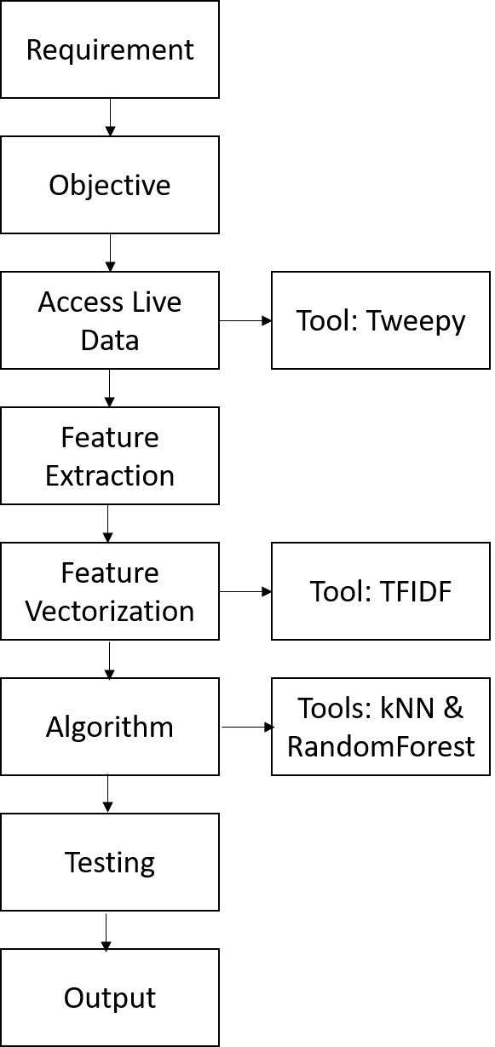
Skeleton flowchart of working principle

Slide 7
Requirements
Functional Requirement
It allows the user to analyse the positive, negative and neutral views of a particular ministry of the government.
It allows the user to look at the statistics twice in the term of the ruling party.
It aids the user to determine to what extent the ministry has been efficient and to understand the impact on the citizens of the country.
It helps to strengthen the public vote by providing satisfactory analysis of the government.
Non Functional Requirements
Reusability - The code is being consistently reused for analysing and classifying the tweets into different categories.
Security - The system is secured enough for the interface
Portability - This system is compatible enough to perform on any platform
Maintainability - This system is easy to maintain
Scalability - This system is scalable to large enough to analyse large amounts of data(tweets).

Slide 8
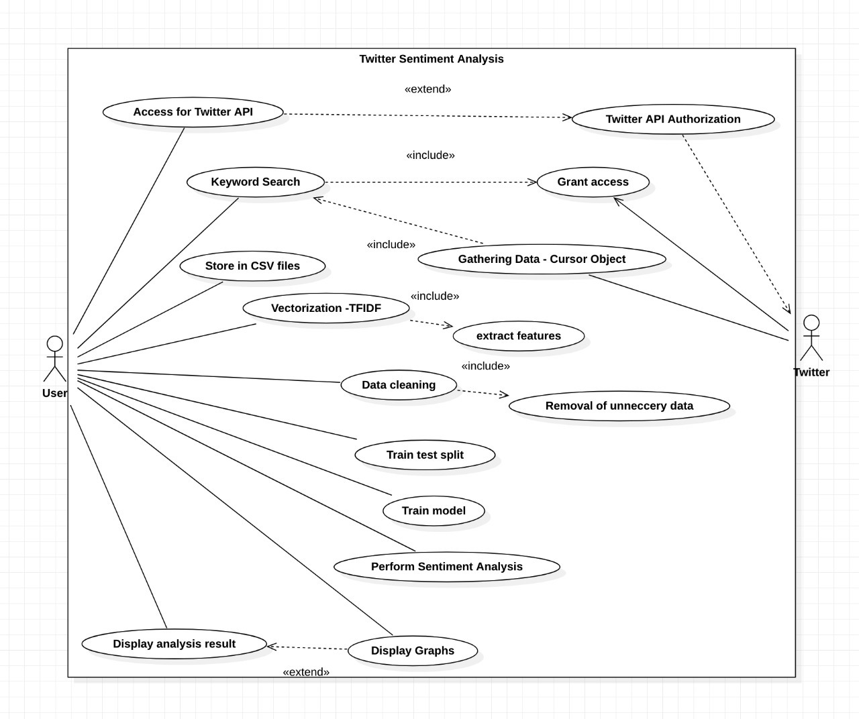
Use Case Diagram

Slide 9
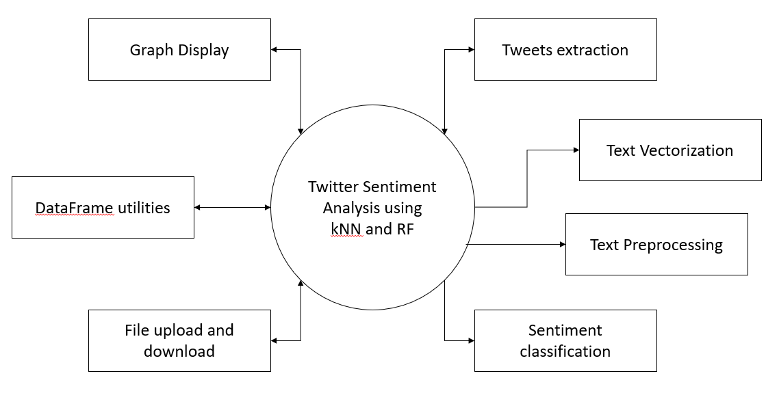
CONTEXT DIAGRAM

Slide 10
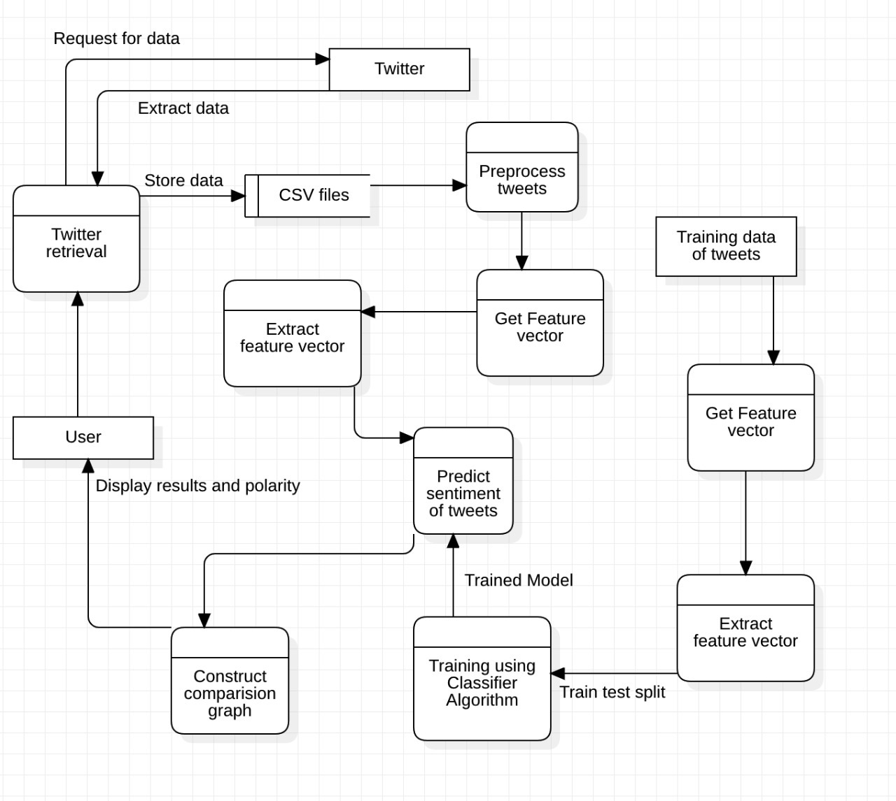
Data Flow Diagram (DFD)

Slide 11
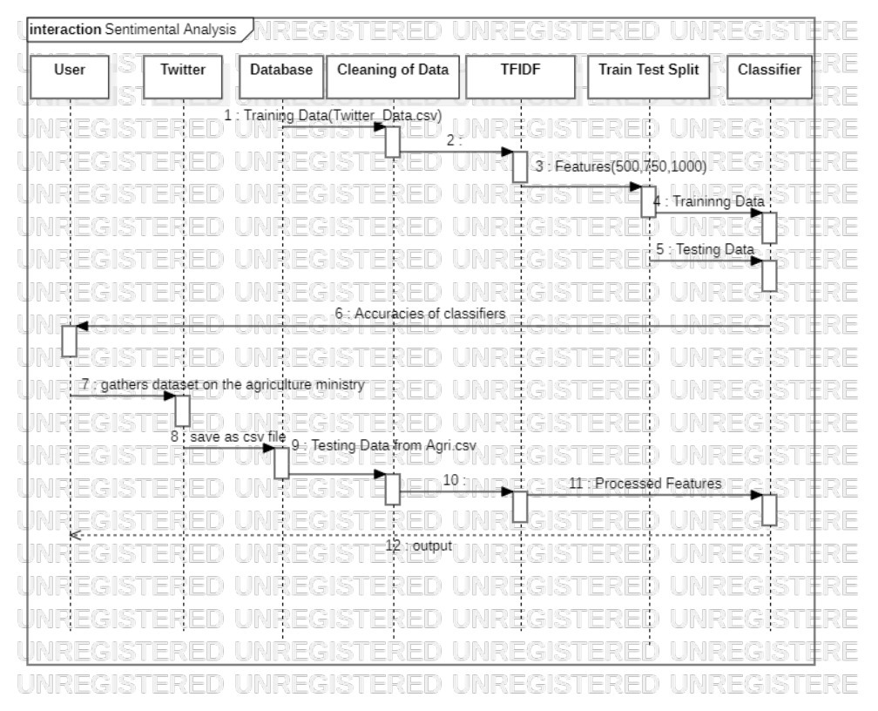
Sequence Diagram

Slide 12
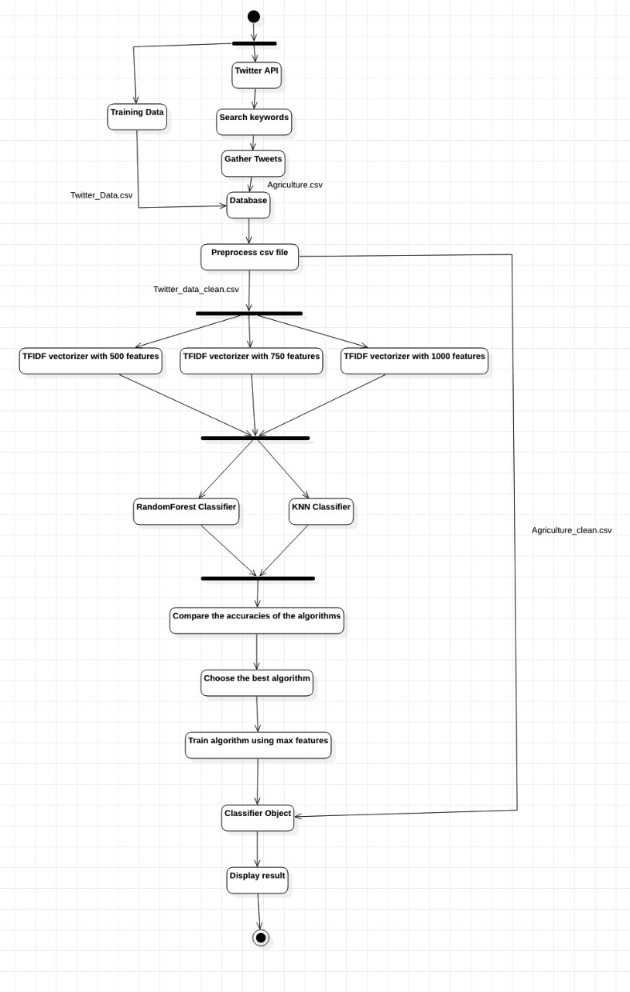
Activity Diagram

Slide 13
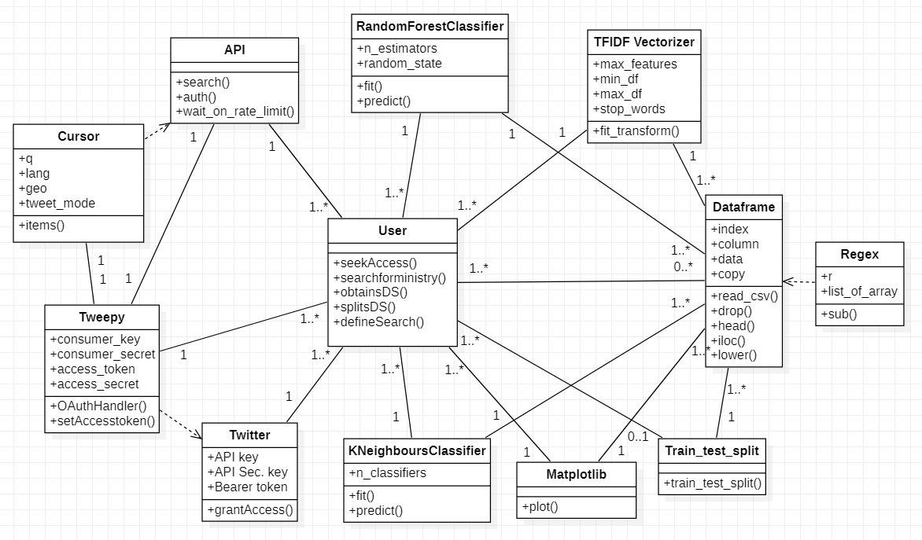
CLASS DIAGRAM

Slide 14
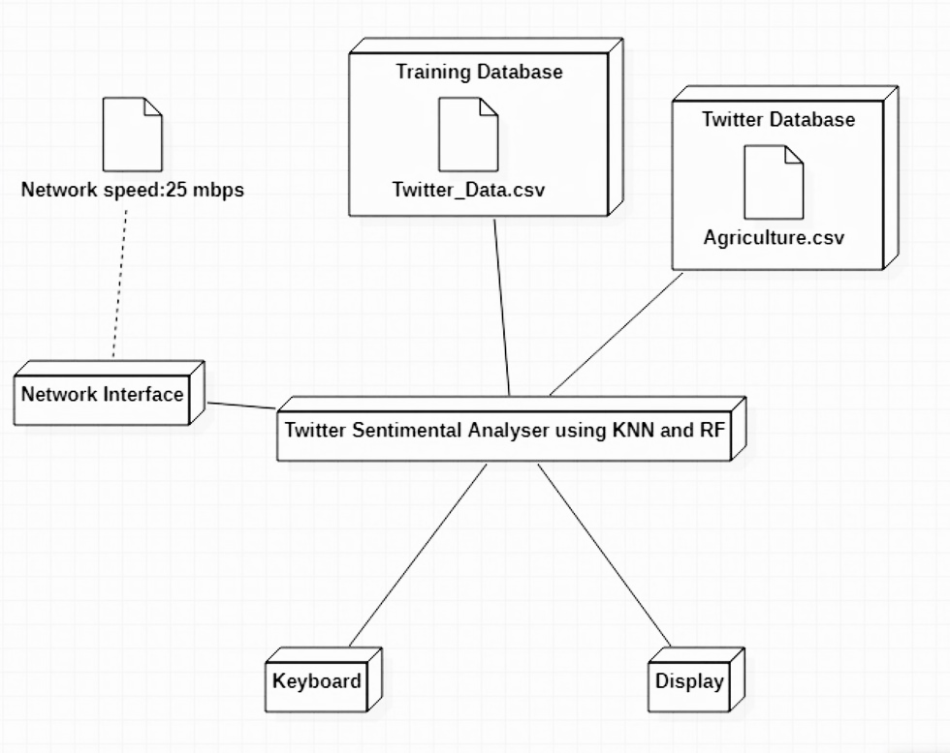
DEPLOYMENT DIAGRAM

Slide 15
STAGE 1: EVALUATING KNN AND RANDOMFOREST ALGORITHMS

Slide 16
TFIDF VECTORIZER
Step 1: calculate the term frequency, the first measure of the score.
tf(w,d)=log(1+f(w,d))
Here f(w,d) is the frequency of word w in document d.
Step 2: calculate the inverse term frequency.
idf(w,D)=log(N/f(w,D))
With N documents in the dataset and f(w, D) the frequency of word w in the whole dataset, this number will be lower with more appearances of the word in the whole dataset.
Final Step: compute the TF-IDF score by the following formula:
tfidf(w,d,D)=tf(w,d)*idf(w,D)

Slide 17
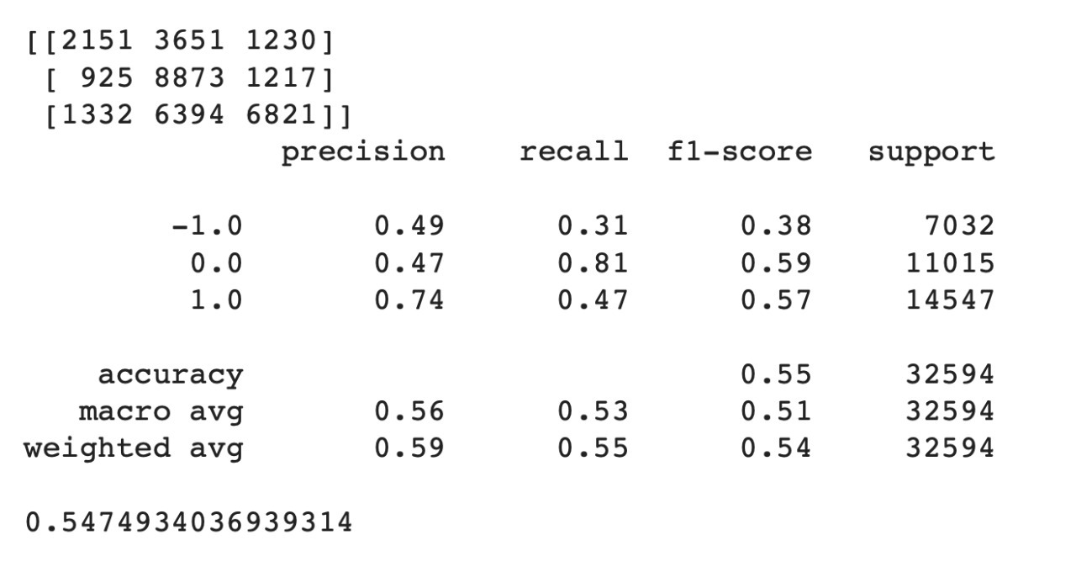
Observations
Output for KNN with max_features=250

Slide 18
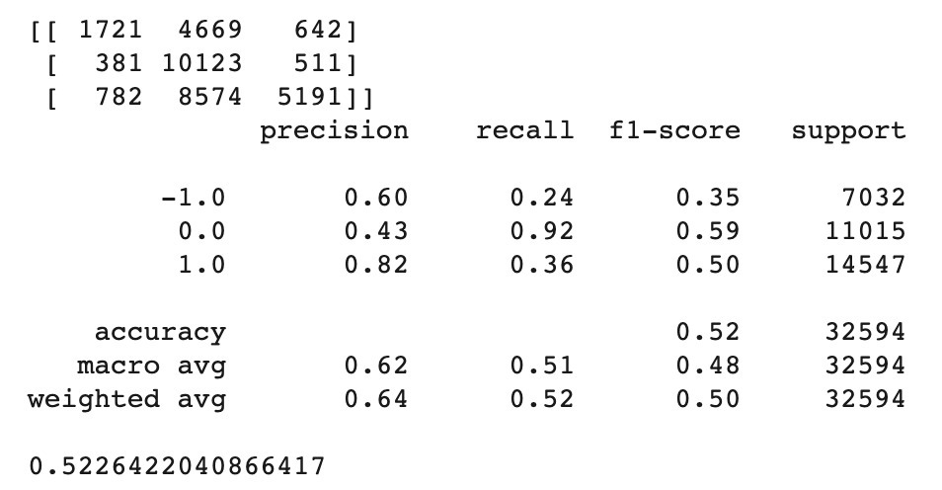
Output for KNN with max_features=500

Slide 19
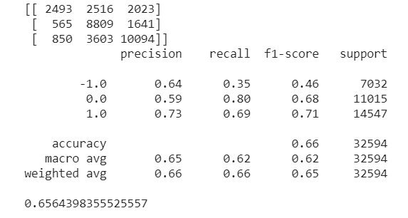
Output for RF with max_features=250

Slide 20
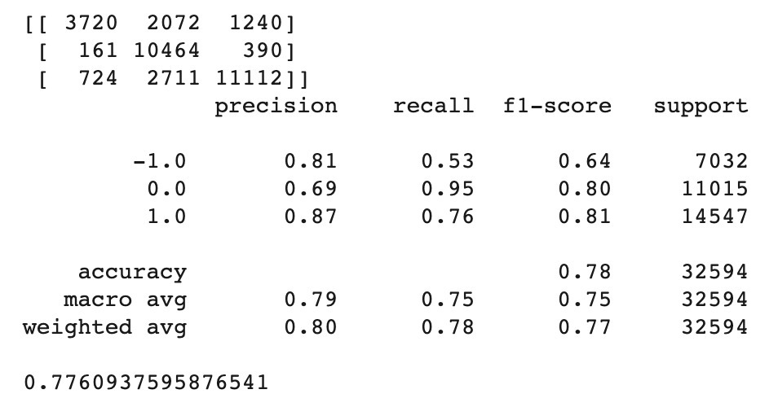
Output for RF with max_features=750

Slide 21
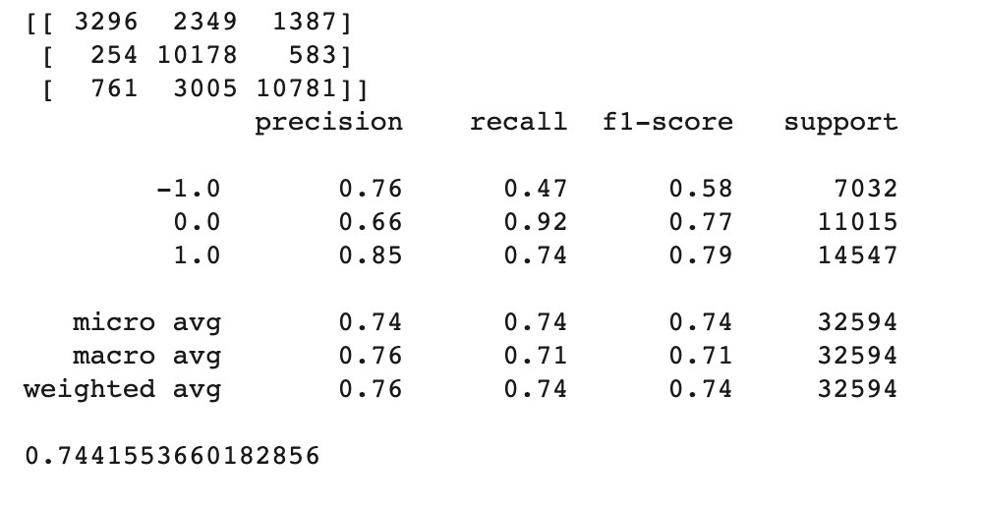
Output for RF with max_features=500

Slide 22
Output for KNN with max_features=750

Slide 23
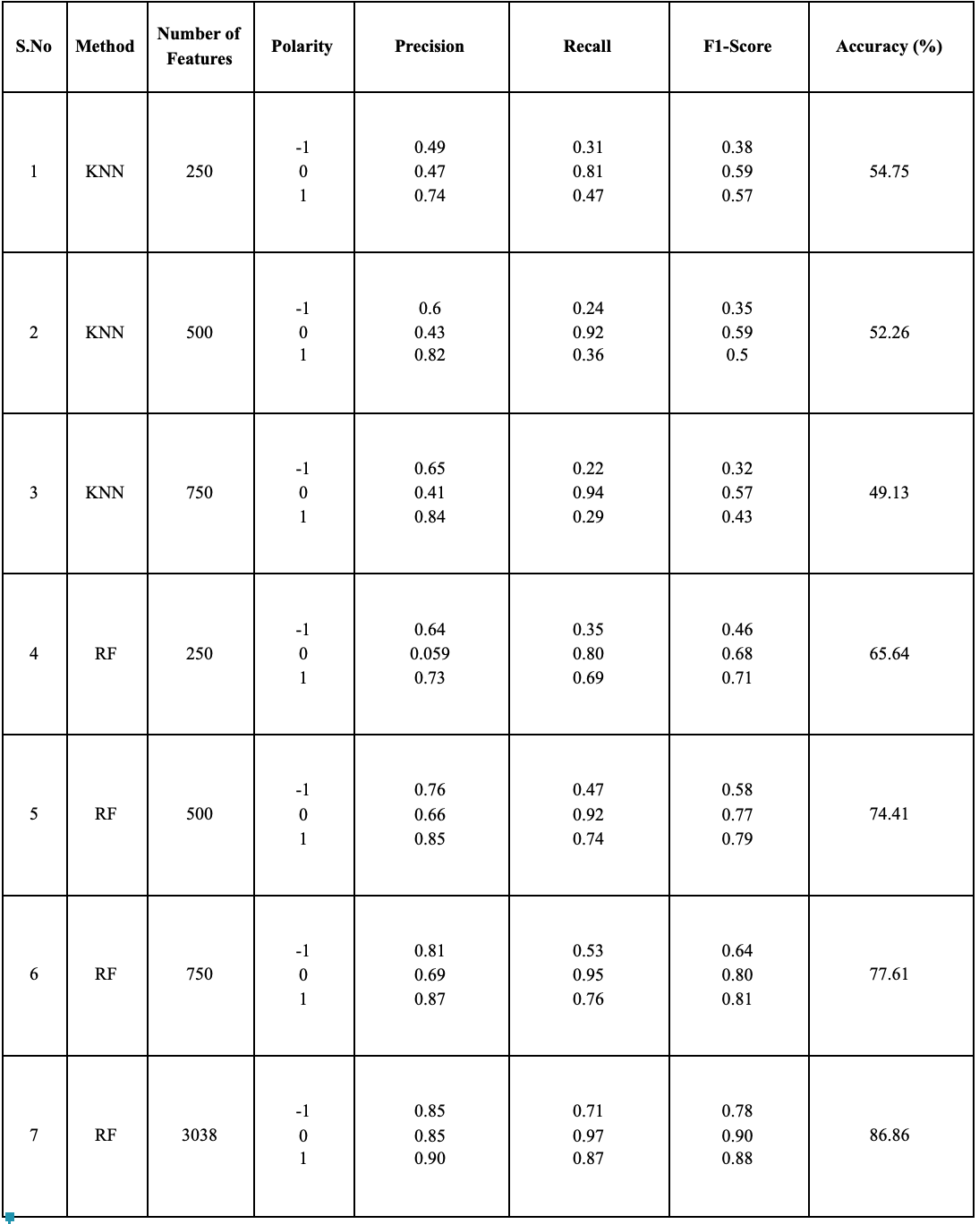
Result

Slide 24
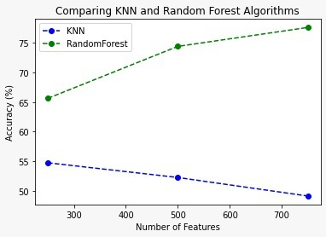
Accuracy measurement of Random Forest Algorithm
When compared to kNN

Slide 25
STAGE 2:
EXTRACTION AND CLEANING OF TARGET DATASET

Slide 26
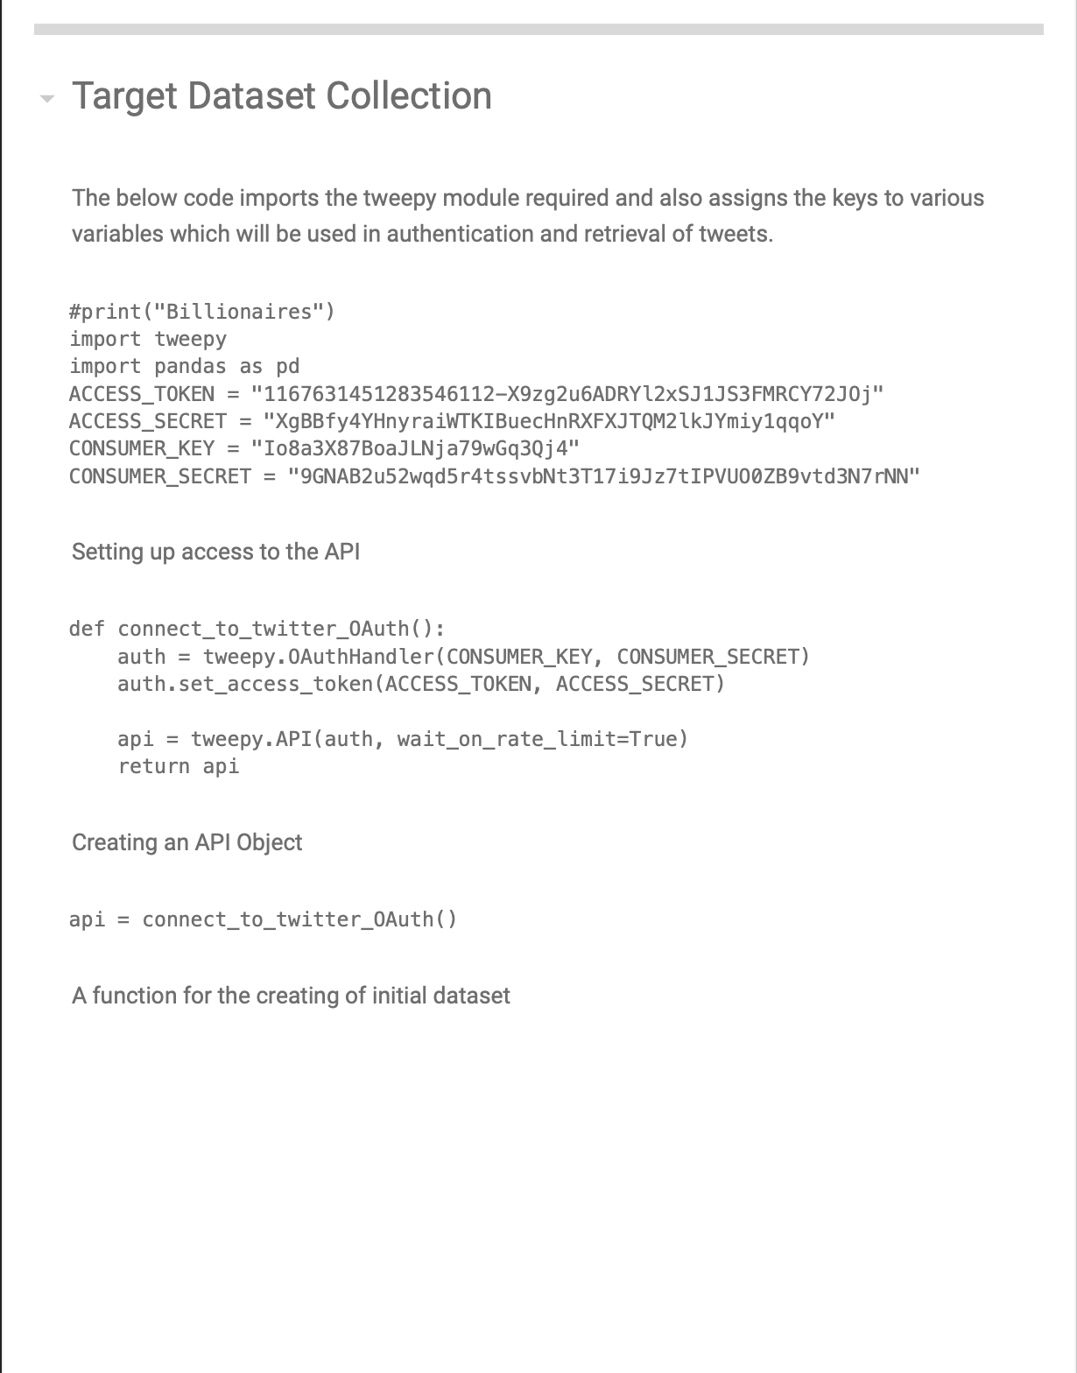
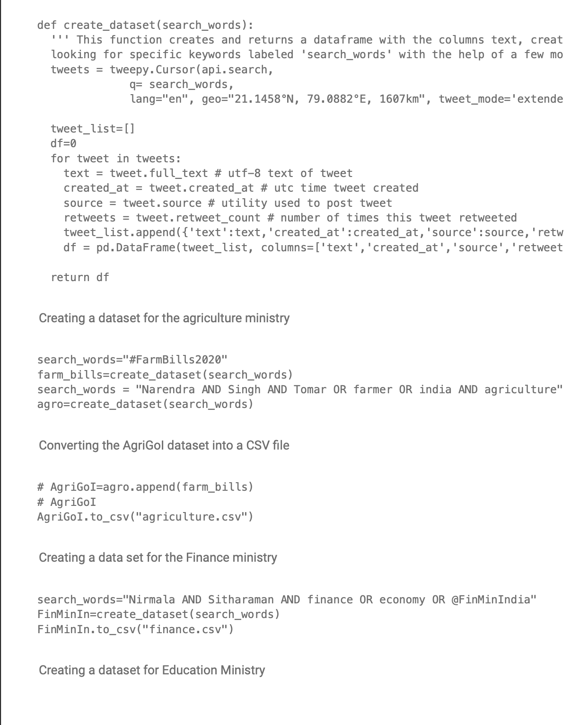
Glimpse of Code base for Data Collection

Slide 27
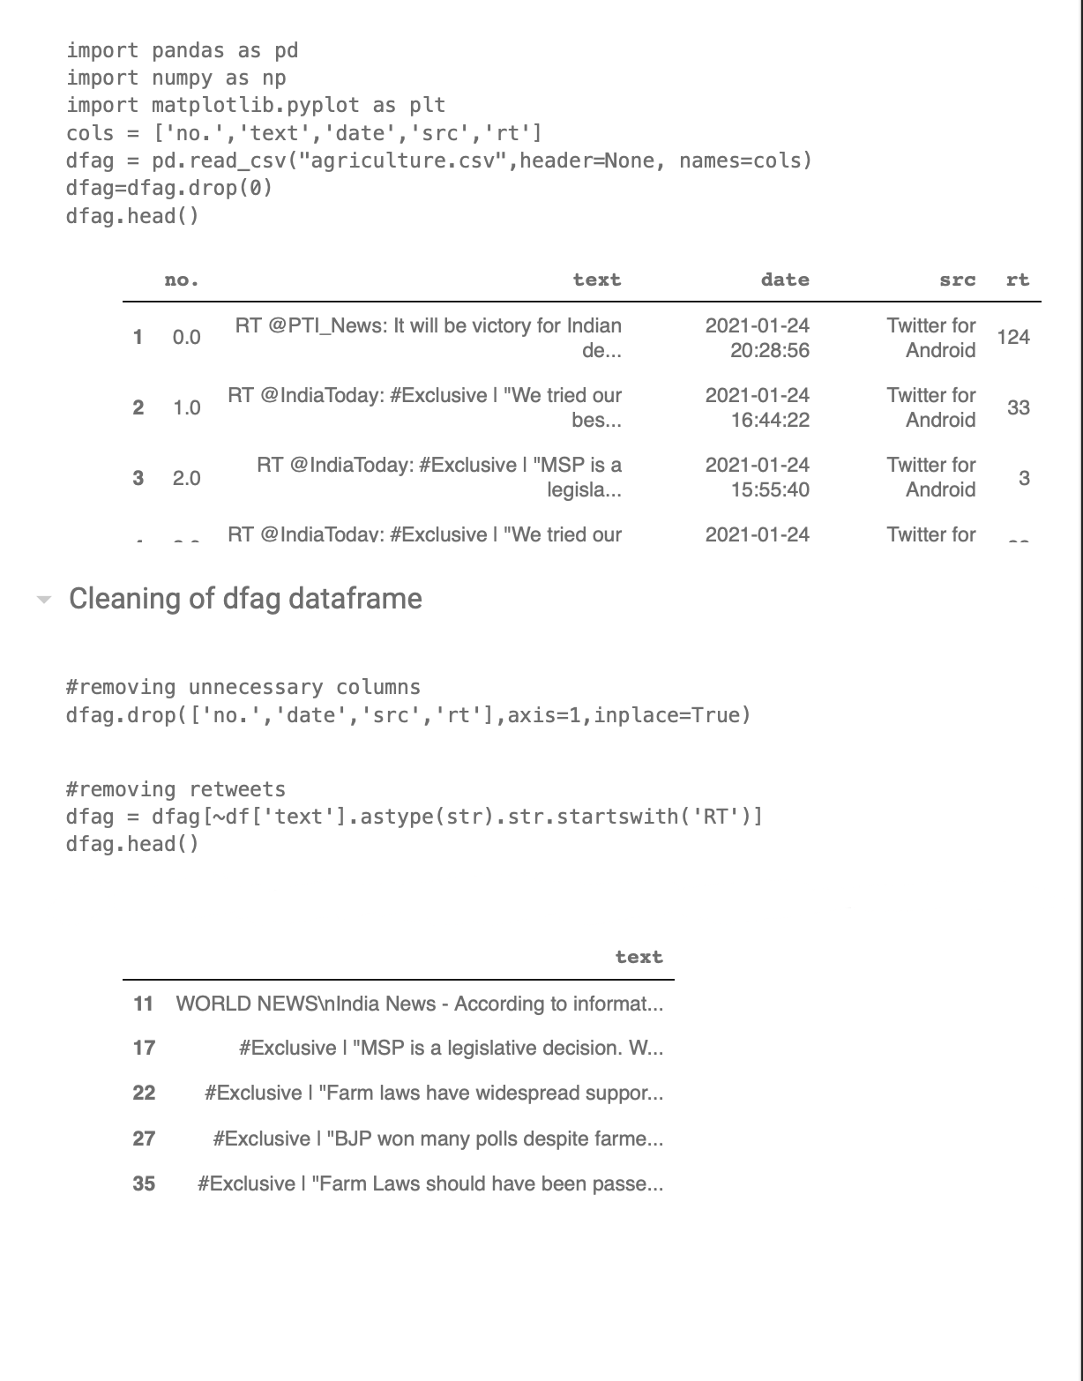
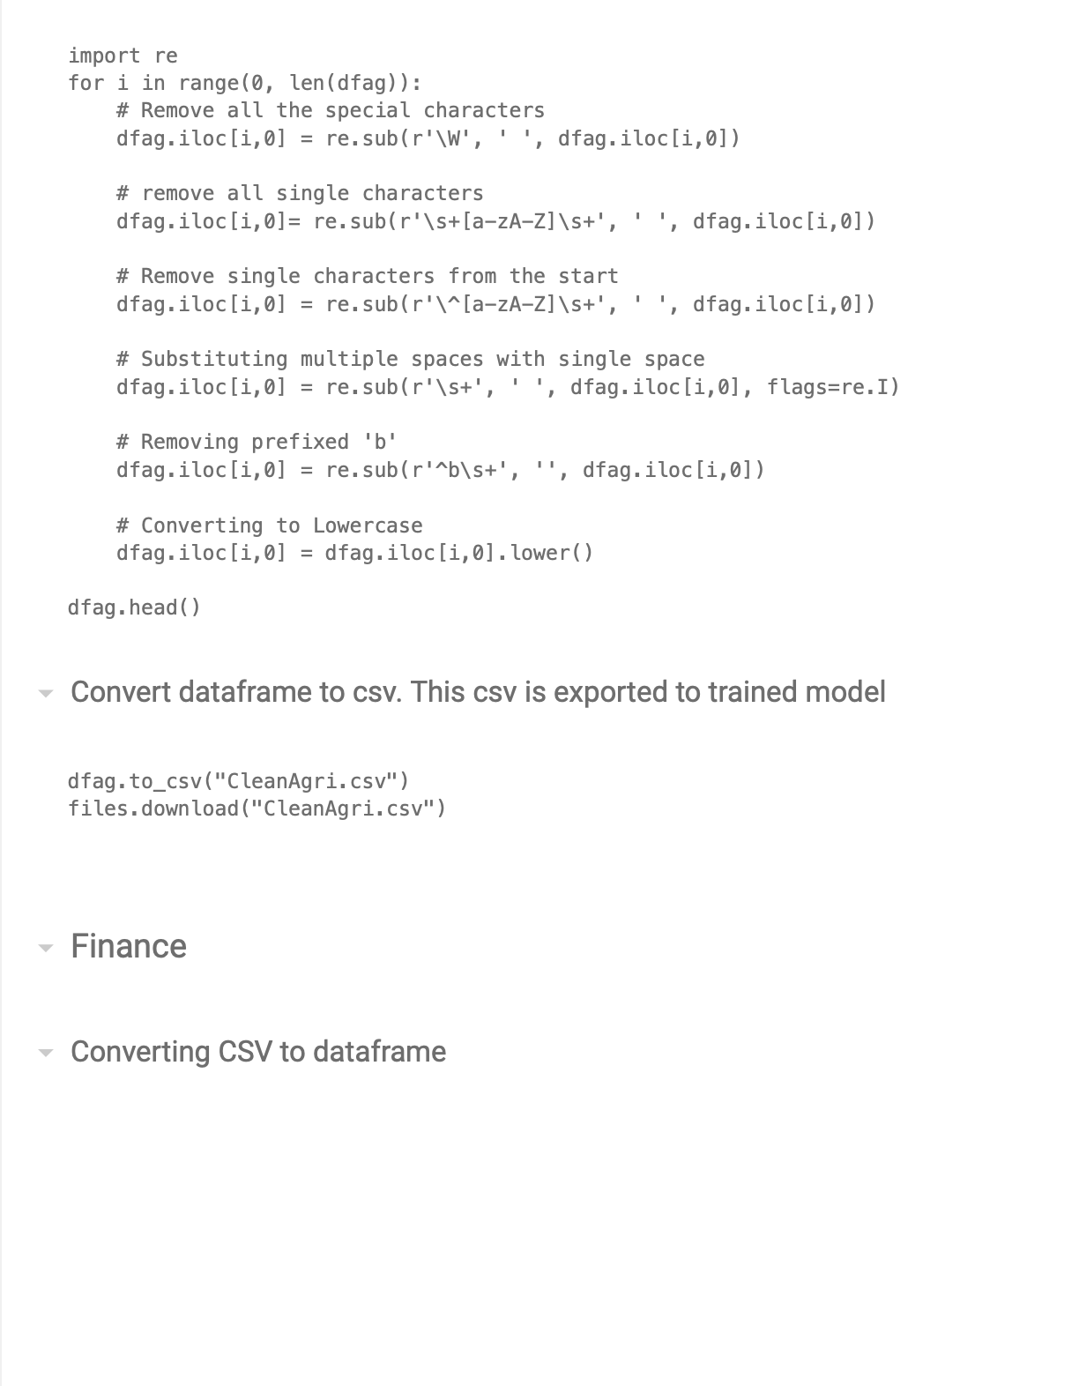
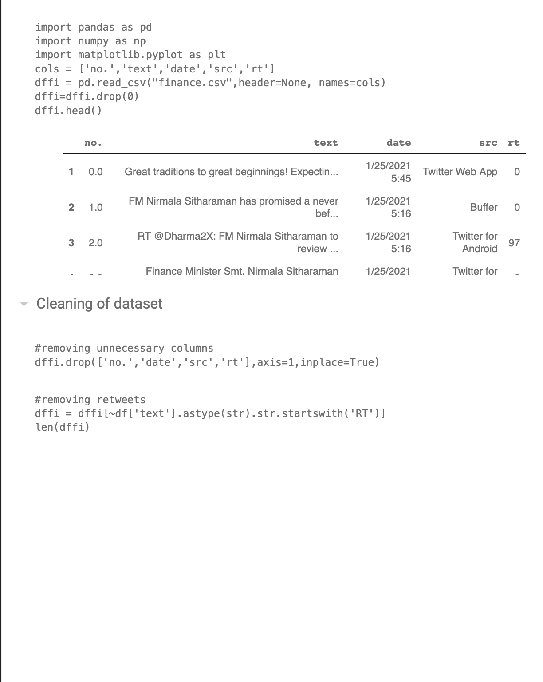
Glimpse of Code base for Cleaning of the Data

Slide 28
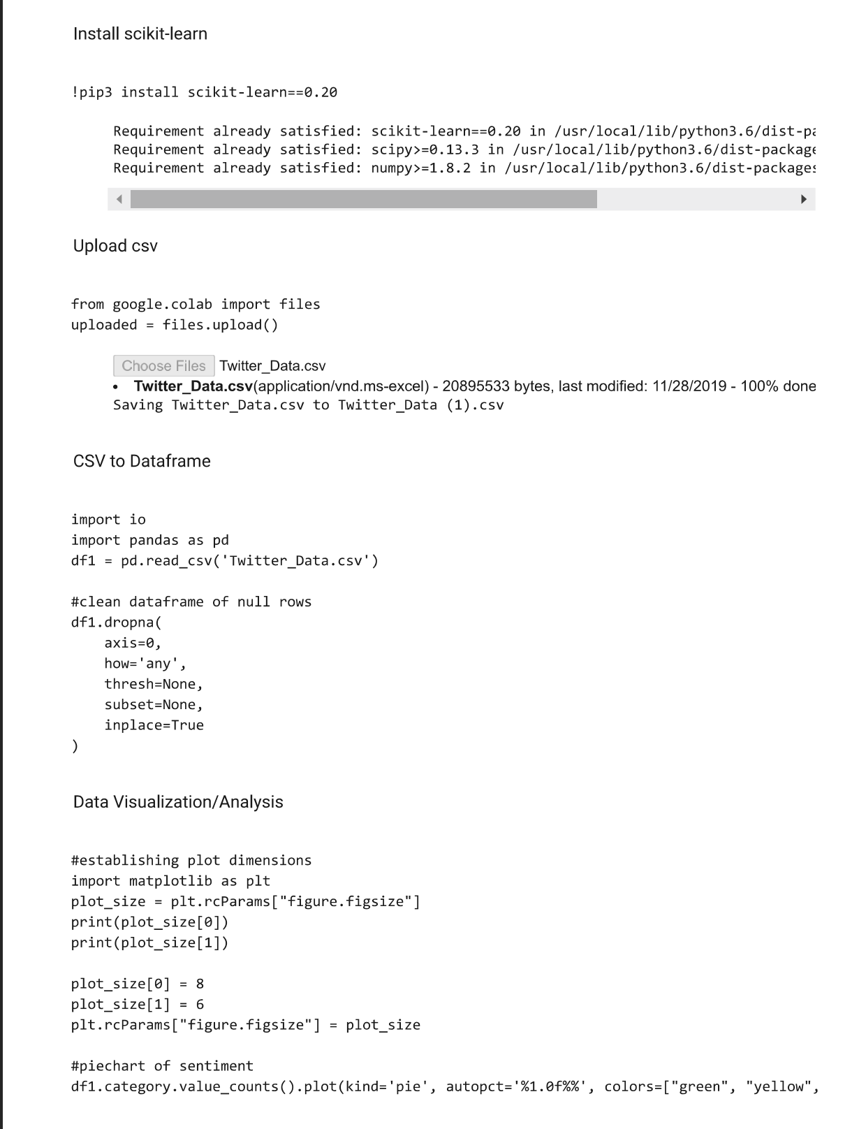
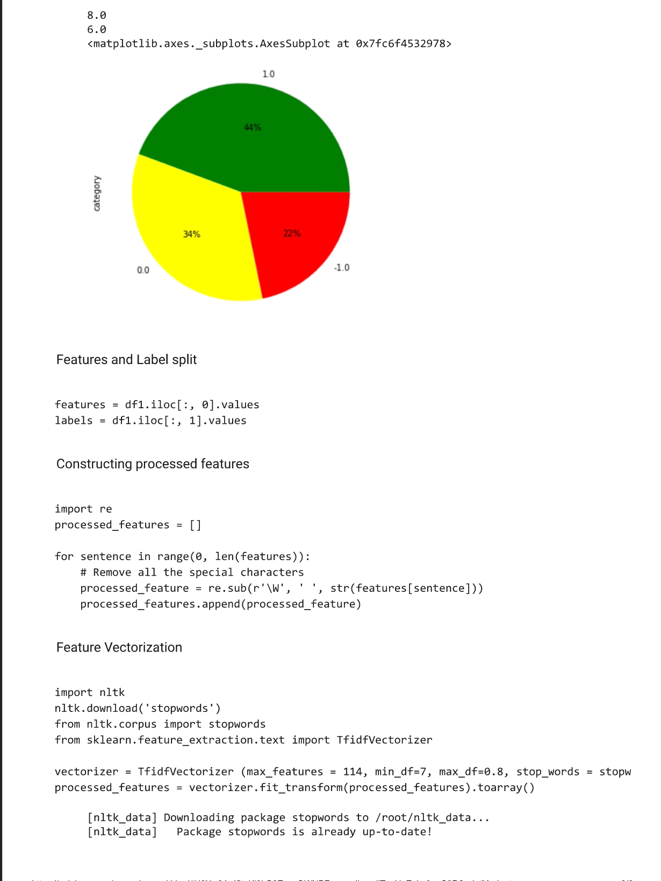
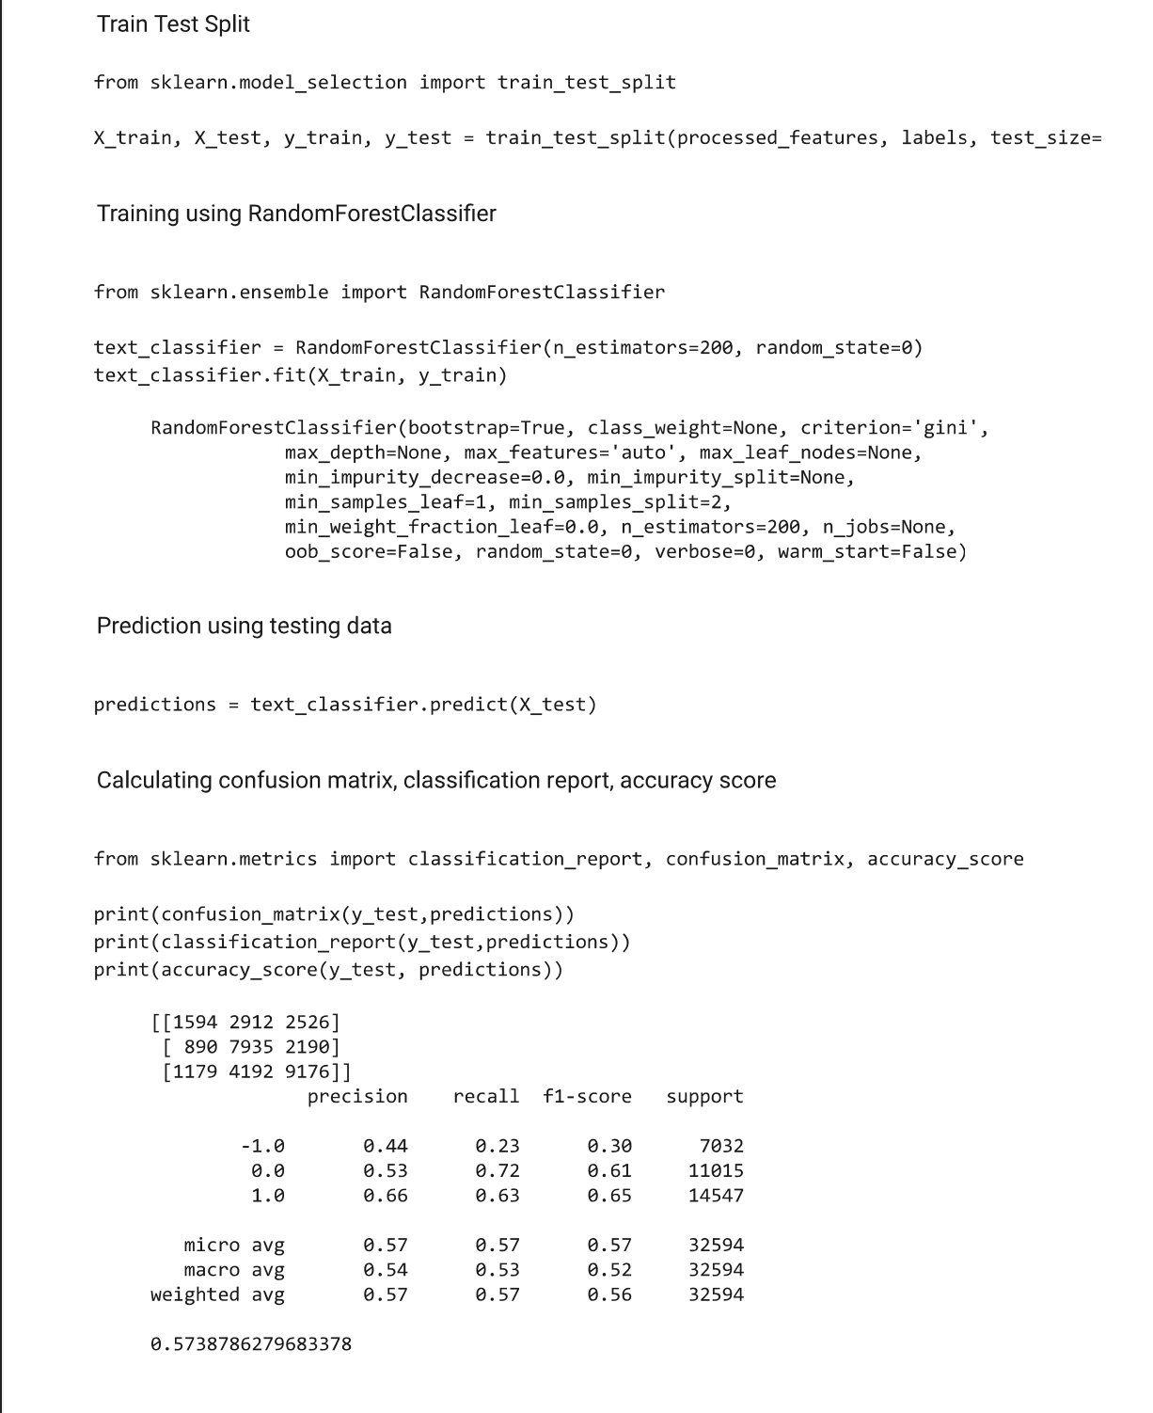
Glimpse of the Code base for Prediction

Slide 29
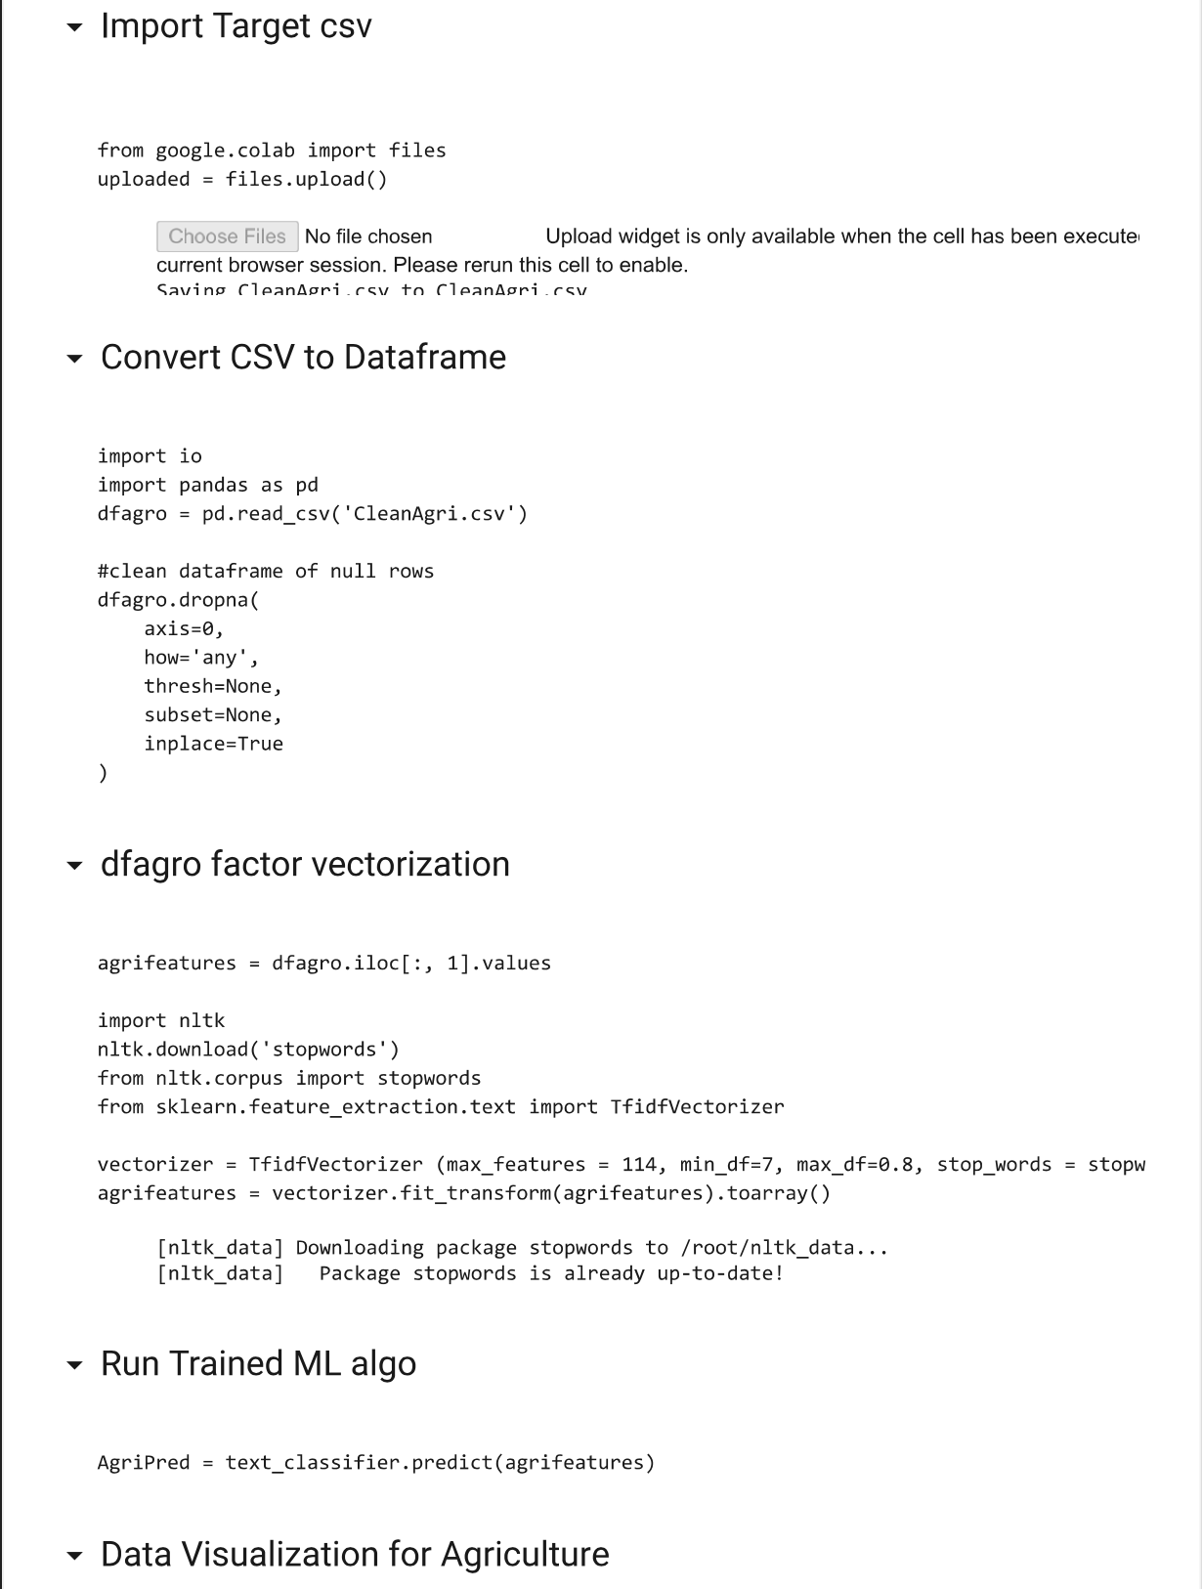
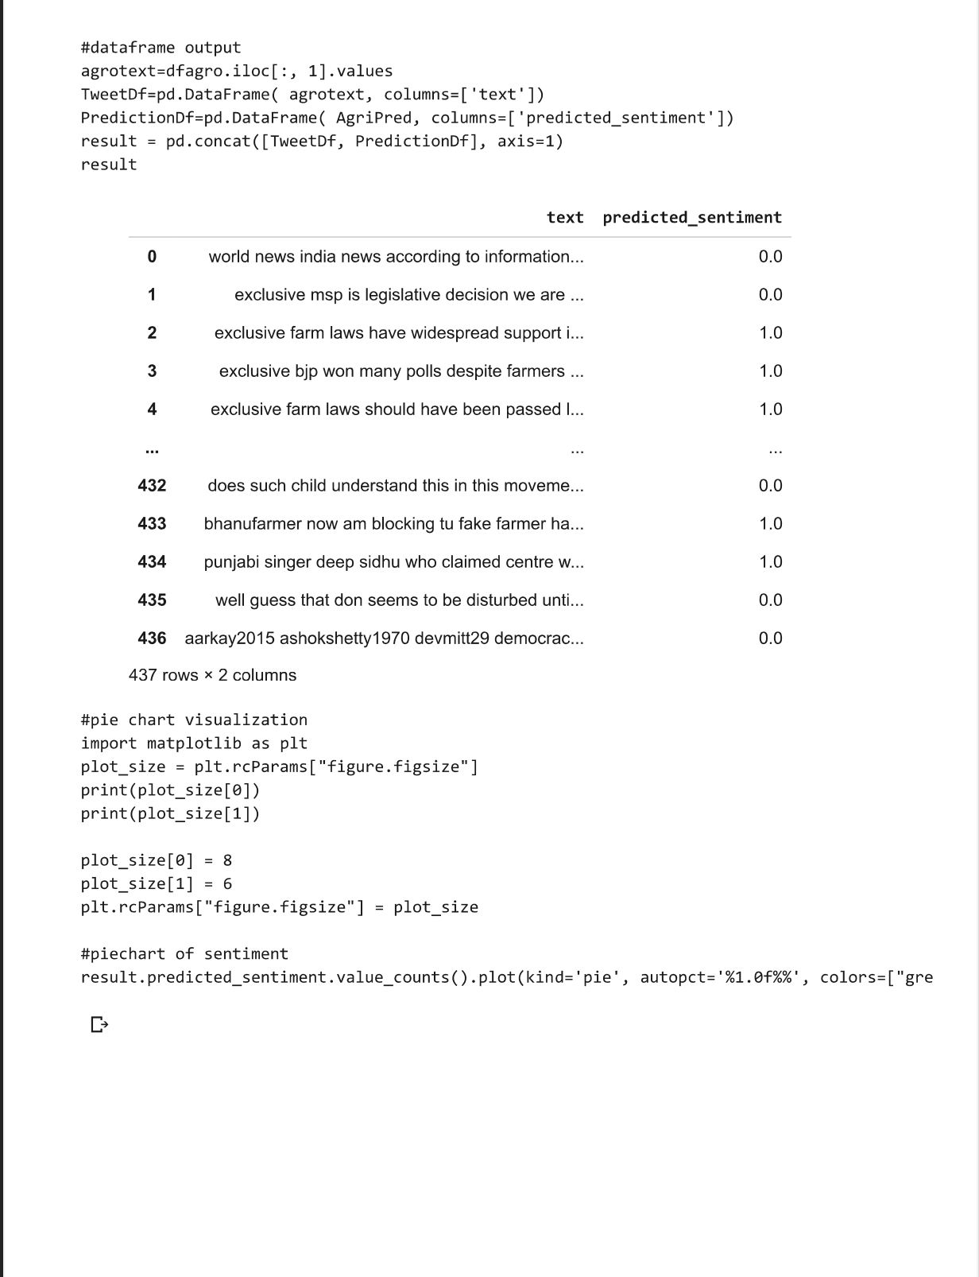
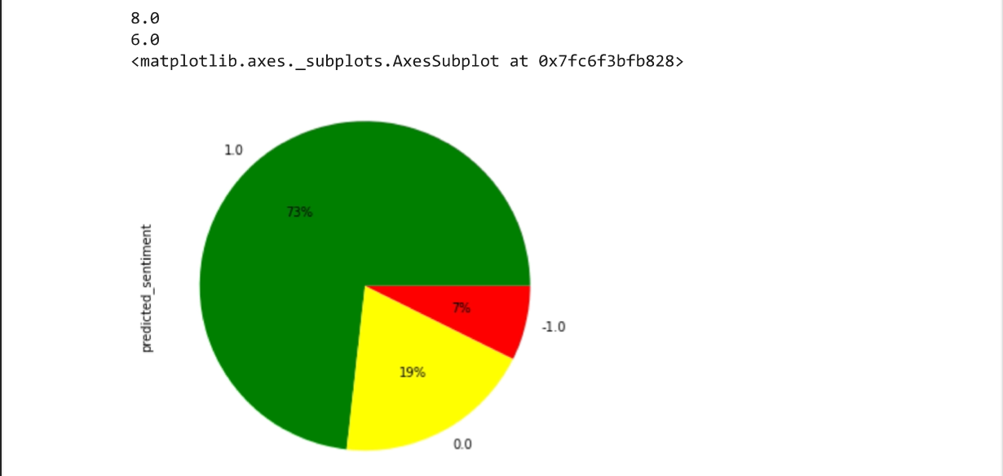
Continued

Slide 30
Code for Data Collection using Twitter API: Tweepy

Slide 31
Data Cleaning
The Data Cleaning of the data is done by:
Remove all the special characters
Remove all single characters
Remove single characters from the start
Substituting multiple spaces with single space
Converting to Lowercase

Slide 32
Code for cleaning of Dataset

Slide 33
STAGE 3: IMPLEMENTATION USING TARGET DATASET

Slide 34
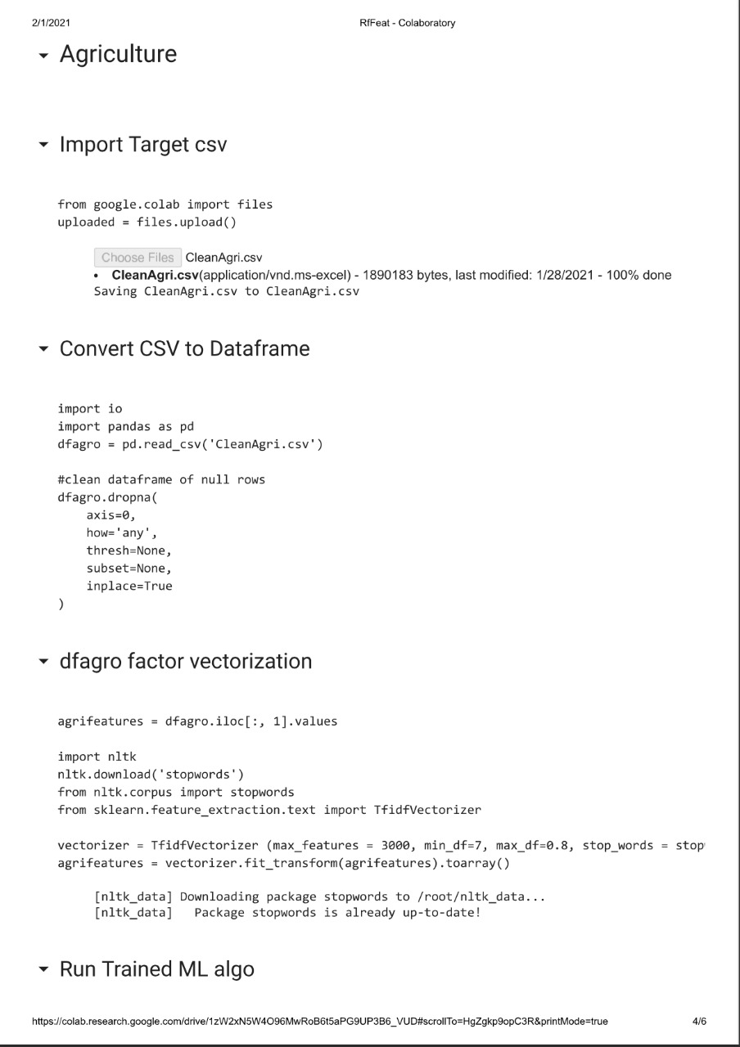
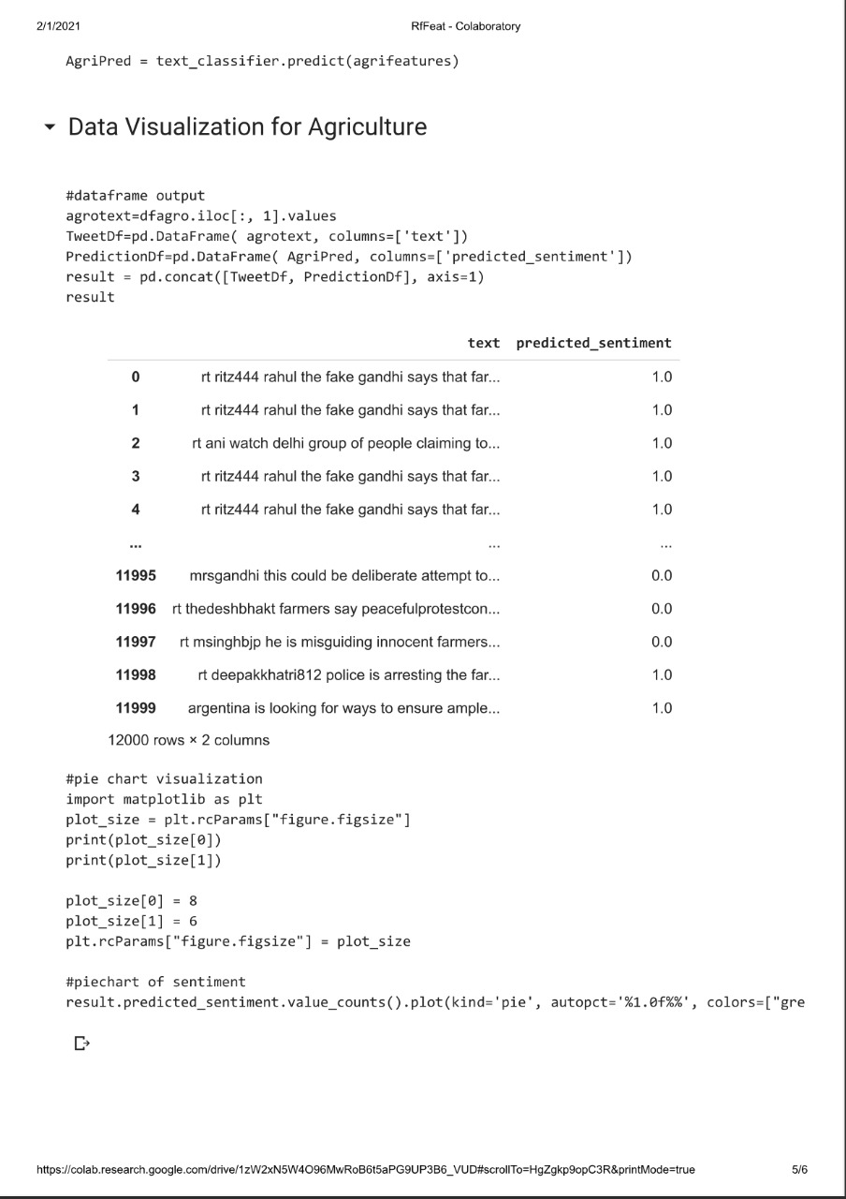
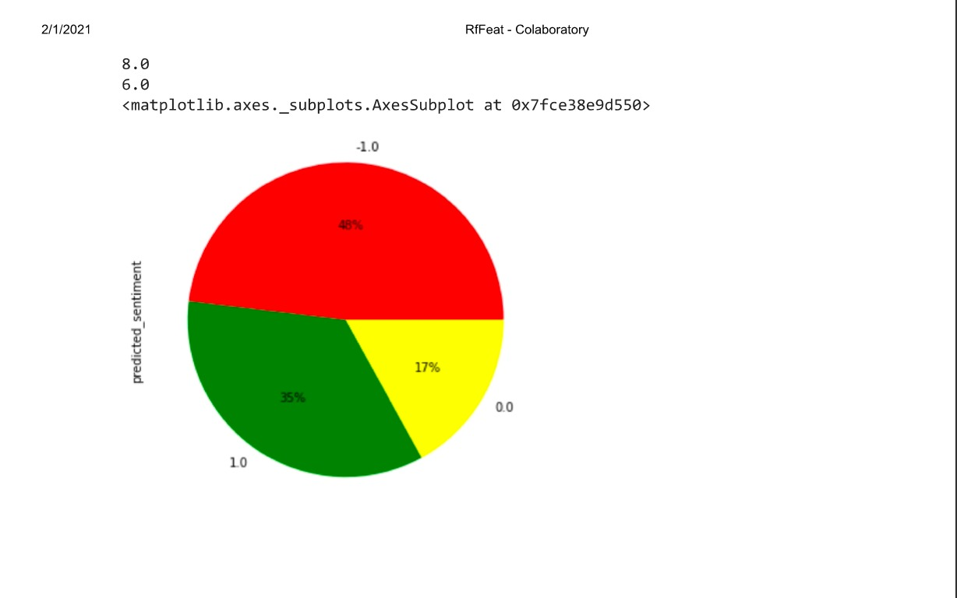
Implementing Agriculture Usecase

Slide 35
OBSERVATIONS

Slide 36
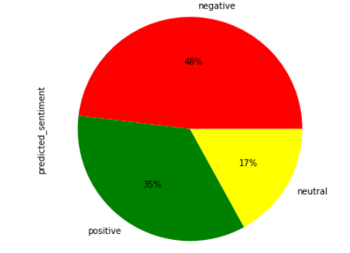
Result on Agriculture Ministry
Random Forest has greater accuracy than KNN
After considering the dataset on the Ministry of Agriculture through the recent tweets, and executing them over RandomForest Classifier Algorithm, we observe that the response is negative towards the concerned ministry

Slide 37
Advantages
Ministries of the government can use this analysis in order to find out the acceptance rate or how the common people feel about various Ministries, for the sake of this project, Agricultural Ministry has been used as a Use Case
This data can be used to depict which ministry has what kind of an opinion in the public and can focus on changing the feeling of the people using the data and figuring out what kind of Bills or Schemes might be better for the people
This gives a visual representation of how well the Ministry has been performing and the outlook of the people with respect to that performance.

Slide 38
Disadvantages
Anomalies such as false positives in training dataset can alter the output
Difficult to determine the value of 'k' nearest neighbours
Noise such as spam tweets or improper hashtags difficult to clean
Irregular size of Big Data corpus for dataset extraction ie one ministry might receive more tweets than other

Slide 39
Future Scope
This can be extended to all the ministries under the Government, and can result in the positive attention towards various ministries.
This can also be used to increase awareness about the various schemes which brings out positive feeling of the people.
This can be extended to not only to the central Ministries but also to various Political Parties in order to gather Data regarding that particular party and how the people feel about that party.
Increase in the target dataset will increase the accuracy of the algorithm

Slide 40
THANK YOU

